Slide 1
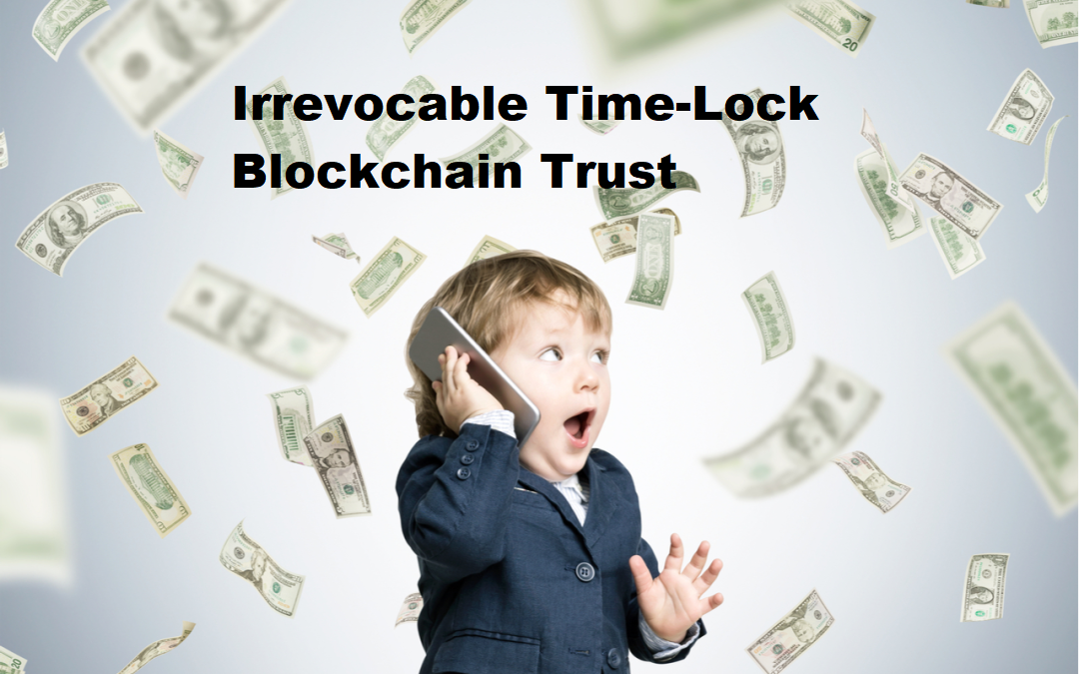
Project by:
David Garcia
Luke Turner
Kyle Jensen

Slide 2

The primary goal of our project is to create a blockchain wallet with a time-lock that acts as an irrevocable financial trust fund.
The trust pays out two beneficiaries from a privately held wallet via smart contract.
Upon submitting and signing the contract to the blockchain these options will become immutable and cannot be changed. Following the contract being signed, it will only pay out after the designated time-lock to the specified beneficiaries.

Slide 3
Financial Trust Funds
There are four main types of trust funds:
Living - made while grantor is alive
Testamentary - of last will and testament, after death
Revocable - able to be changed
Irrevocable - unable to be changed, cannot be both grantor and trustee
Notes:
Can talk about differences in trust. Why we decided to do an irrevocable trust vs. other options.

Slide 4
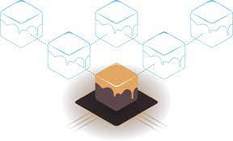
Ganache
Ganache supports development of Ethereum and Corda blockchain
We were able to troubleshoot some code by hard-coding in specific wallet addresses
Worked quicker when waiting for blockchain updates when editing/troubleshooting

Slide 5

Solidity and Ethereum
First language for smart contracts
Most widely used language on Web3
Primary language on Ethereum
Ease of use for compiling and testing code
Object oriented programming (Oop)
Using ERC20, the technical standard for smart contracts on the blockchain

Slide 6

Streamlit
We used Streamlit for our front end deployment of the trust smart contract
Buttons and boxes were added to the GUI for end user ease of use

Slide 7

Remix IDE
Used for compiling solidity code
Troubleshooting was easier
Connected with Ganache

Slide 8
Results
We were able to make an irrevocable time-lock trust per our original goal. We had to make several adjustments as we progressed through the project.
Namely, having our program only being able to work with two beneficiaries to a single trustee.
However, we were able to meet our goal of having variable time amounts for the time-lock. We also we able to limit the payouts to the specified beneficiaries. The contract was also made immutable once signed.

Slide 9
Demo

Slide 10
Unanticipated problems
We were unable to use a Metamask approach due to inefficiencies in testing and troubleshooting the code.
Explored mapping function, not used due to withdrawal only being allowed if address was also the depositor
When running Steamlit the nonce would not properly iterate after constructing a contract instance. We used “session_state” function to resolve.
Mimicking functions that are native to remix such as: environment, values, gas, account, and especially deploy.

Slide 11
Future Additions
Possibility of interest or APR for ETH invested in the trust
Expanding to multiple beneficiaries beyond two
Automation of time-lock payouts
Choose different types of trust (living, revocable, charitable, etc.)

Slide 12
Credits
Github: https://github.com/CincoCoding/Irrevocable-Time-Lock-Blockchain-Trust
Luke Turner
David Garcia
Kyle Jensen

